Slide 1

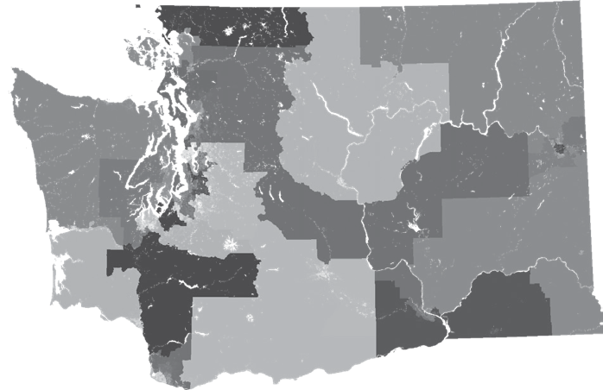
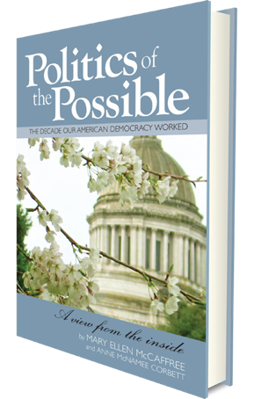
®
Districts We Can Believe In
Presented By:
Alison McCaffree
League of Women Voters of Washington
Politics of the Possible in Action
Notes:
Introduce
Presenter
League Leadership if any in attendance
Elected Officials

Slide 2

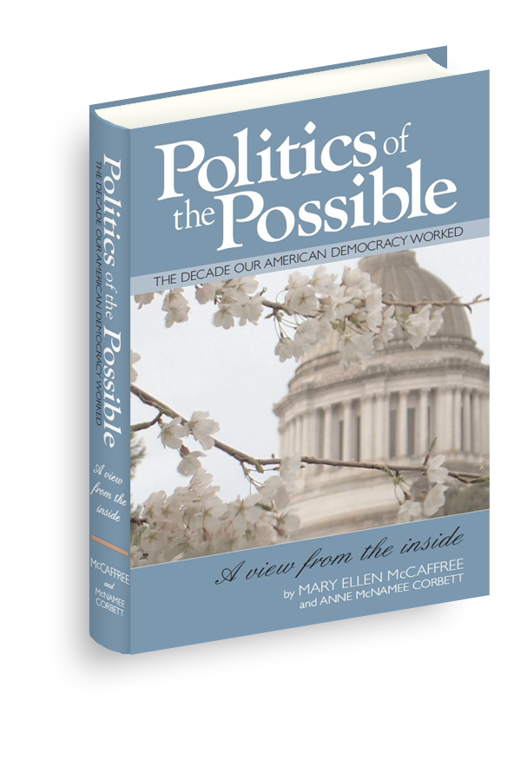
Nonpartisan Nonprofit
  Inspire action through stories of civic engagement
  Enhance civic education
  Create cultural change to honor public service
Director: Alison McCaffree
Notes:
Non-partisan Organization
Increase citizen engagement
Increase civics knowledge
Honor public service
Philosophies of
Mary Ellen McCaffree
Manager: Alison McCaffree
Mechanical Engineer
Business woman
For profits and nonprofits
Startup & high growth

Slide 3

Redistricting Reform
Outreach – 2020 Census
2020 Legislative Changes
Commissioner Selection
Testify School
Drawing 2021 Maps
2031 Commission Structure
Notes:
Understand basics of Redistricting and Reapportionment processes
Understand the history and importance of redistricting to political power
Action Plan – Discuss what actions you can take to improve our democratic process
Introduction
Definitions
National View
Washington State View
Questions

Slide 4

Citizen Action
You know enough
No action is too small
Many actions add up
Learn by doing
Ask: We are here to help
Notes:
Understand basics of Redistricting and Reapportionment processes
Understand the history and importance of redistricting to political power
Action Plan – Discuss what actions you can take to improve our democratic process
Introduction
Definitions
National View
Washington State View
Questions

Slide 5

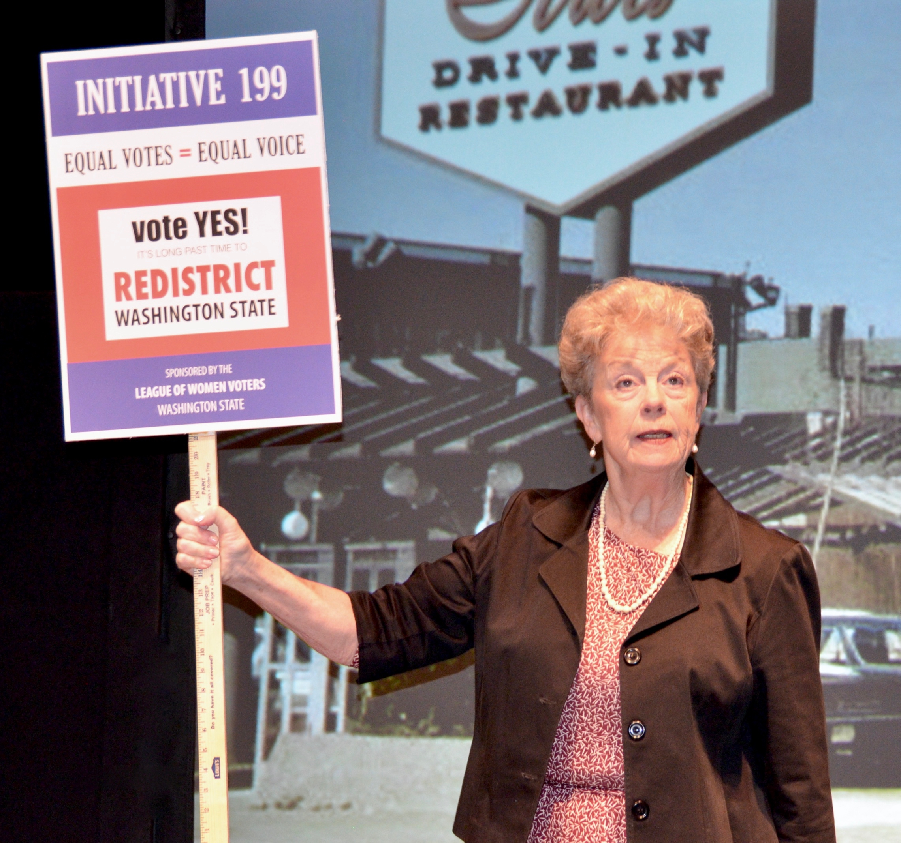
Many Maps,
One Voice
LWV Tribute
Marketing
Education
Civic Engagement
Todays Issues

Slide 6

Centennial Grants Program
High Schools
  Seattle (Fall 2019)
  Spokane (Spring 2020)
Pre-Post Play Modules
Public Performances

Slide 7
2020
CENSUS
Outreach

Slide 8
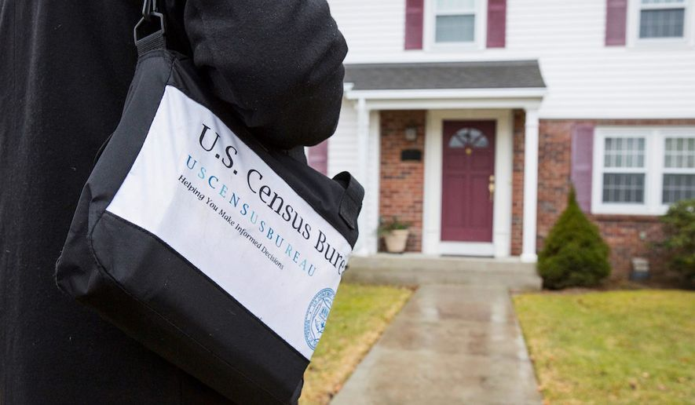
Yes.
Illegal – fines not inforced
Cost to send someone out – if done’ return
If you return – No one comes to your door.
Notes:
Should people simply not answer the citizenship question if it stays on the form?
Response to the decennial census is required by law. There are penalties for not answering census questions ($100 fine) and for providing false responses ($500 fine). The Census Act also prohibits any action that is intended to cause an inaccurate enumeration ($1,000 fine and/or up to one year imprisonment). The Census Bureau, however, is a statistical agency and does not enforce the law; that responsibility falls to the Department of Justice. As a practical matter, the Census Bureau uses the “carrot approach” to encourage full participation in the census and does not refer cases of nonresponse to DOJ for prosecution.

Slide 9
Why is the Census Important?
Allocates representation
Allocates Billions
in federal programs
Guides research and critical questions
U. S House of Representatives
State Legislative Districts
Local Governments, Schools and Fire Districts
  $900 Billion nationally (2020 estimate)
  Washington State receives $14B federal funds annual
  Businesses
  Nonprofits
  Universities
Notes:
Allocate representation
U. S House of Representatives
State Legislative Districts
Local Governments with Districts
Allocate $675 Billion in federal programs (2015)
Medical Assistance ($311B)
Supplemental Nutrition “SNAP” ($71B)
Medicare Part B ($70B)
Highway Planning and Construction ($38B)
Federal Pell Grant Program ($30B)
Research and Decide Critical Questions
Businesses – Ex: Where does Walmart put its next store?
Nonprofits – Ex: Where to have services
Universities – Population Shifts

Slide 10
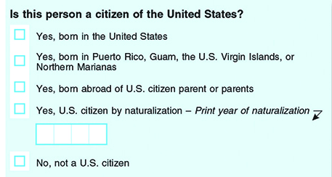
Citizenship Question
The survey does not ask whether noncitizens are legally in the country.
Notes:
The 1950 census form asked where respondents were born and whether they were naturalized.
In 2016, we tested changes to questions on 10 topics,” said Victoria Velkoff, chief for survey of the American Community Survey Office. “This test is a critical step to make the ACS questions current and easy to answer.”
The content test looked at changes to these subjects:
Telephone Service
Computer and Internet Use
Health Insurance
Journey to Work
Weeks Worked
Class of Worker
Industry and Occupation
Retirement Income
Relationship
Race and Hispanic Origin
If approved, the Census Bureau will implement these proposed changes in January 2019. See highlights of the testing and outcome for selected topics in the sections below.
(The Census Bureau is legally required to keep answers confidential, even from the FBI and other government entities. That means it isn't allowed to release data identifying an individual. But federal agencies and researchers can request census information on specific population groups.)
Critical step to make questions current and easy to answer
Experts know question will hurt response & accuracy
17 states, DC 6 cities sueing to block
1950 = The last time ALL U.S. households asked
1070-2000 Short form (1/6)
2010 American Community Survey (3 million households)
2016: tested changes to questions on 10 topics
Current citizenship question not following the process.
Legally required to keep answers confidential

Slide 11
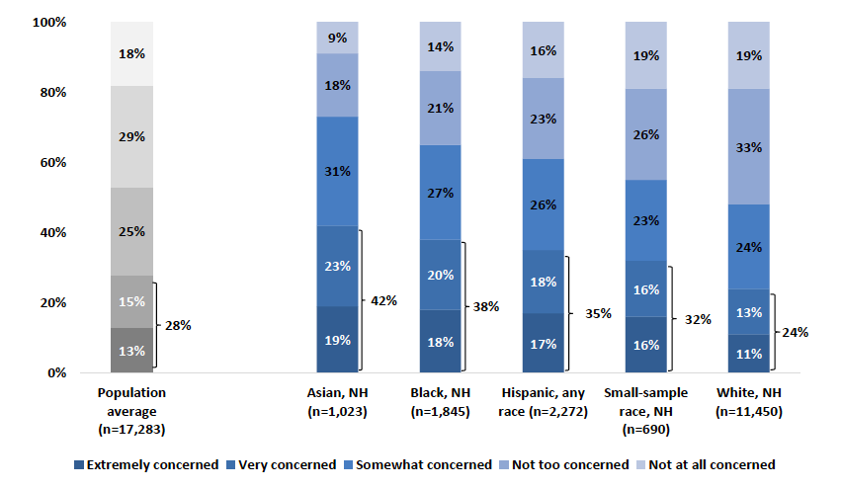
Census will NOT keep my answer Confidential
Asian Black Hispanic Other White
42%
38%
35%
32%
24%

Slide 12
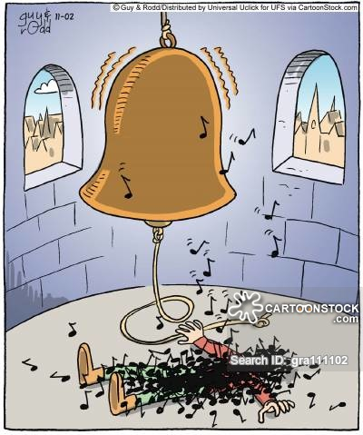
You
Can’t
Unring a Bell

Slide 13
Census Outreach Funding
$15Million State Funding
$1.6M Seattle & King Co
Local Government
Community Based Organizations
  Washington Census Equity Fund
Increase communication and coordination
Support education, community outreach, regional communications, policy advocacy and other “Get Out the Count” activities
Prioritize funding for outreach in hard-to-count communities

Slide 14
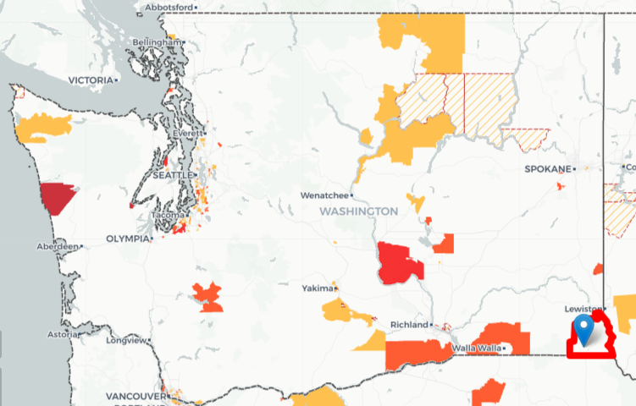

Hard to Count: Washington

Slide 15
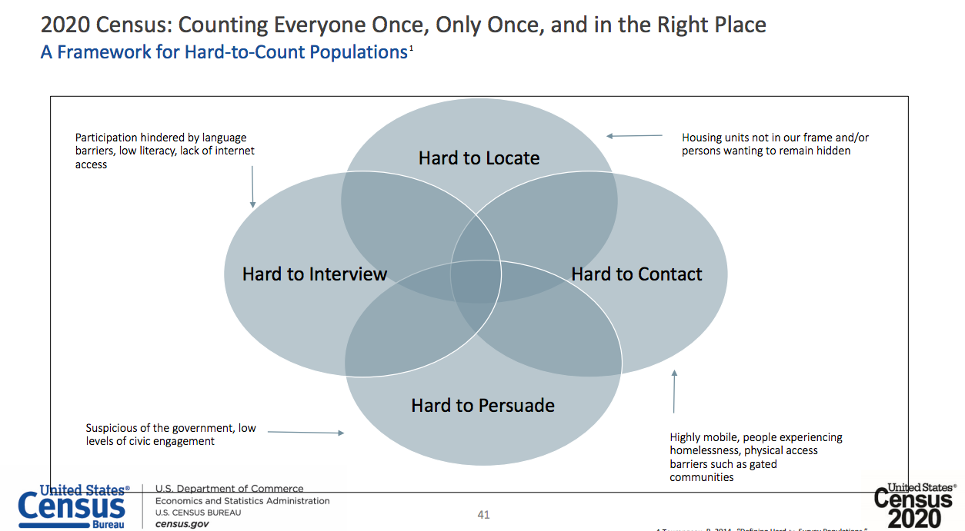
Framework for Hard-to-Count

Slide 16

Outreach Communications Tips
Acknowledge the fear
Empower with the facts
Who is your audience?
Relate stories on impact
Find a trusted messenger
Notes:
Understand basics of Redistricting and Reapportionment processes
Understand the history and importance of redistricting to political power
Action Plan – Discuss what actions you can take to improve our democratic process
Introduction
Definitions
National View
Washington State View
Questions

Slide 17
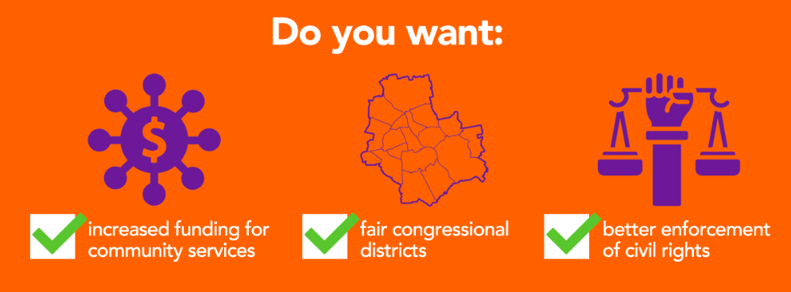

Slide 18
Complete Count Committees
Notes:
ensure all geographies and cultural and linguistic communities are fully and accurately counted

Slide 19

Goal: Statewide Coverage
®
®
®
®
®
®
®
®
®
®
®
®
®
®
®
®
®
®
®
20 Local Leagues
49 Leg Districts

Slide 20
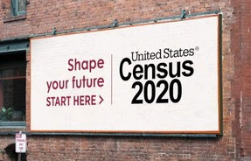

Slide 21
Census Actions
®
Funding from State Government
  Encourage CBOs to apply for money
  Fundraise additional money to support outreach & communication
Community Organizing
  Reach out to hard to count communities
  Customize materials
  Hold parties.
  Help at libraries

Slide 22
2020
REDISTRICTING
REFORM BILLS

Slide 23
2019 Bills
Passed:
SB 5287 - Prison Gerrymandering
SB 5496 - Precinct Boundaries
SB 5502 – End deadlines
Withdrawn:
HB 1396 - Efficiency Gap &
Campaign Prohibitions

Slide 24
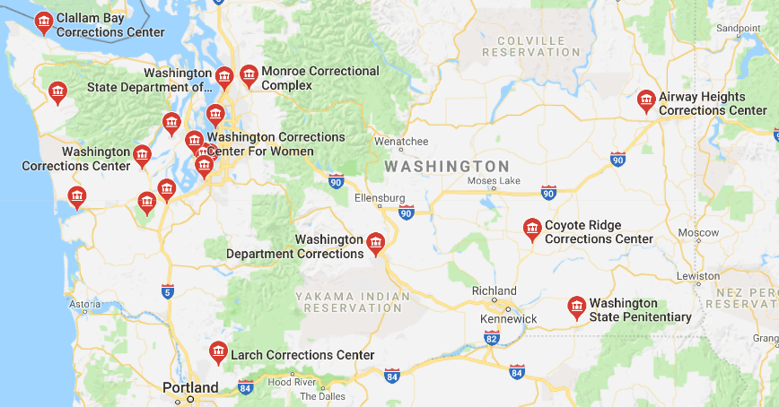
WA State Prisons
SB 5287 was signed
into law on May 11th
Notes:
2019 Bill - 2SSB 5287 – will address this.

Slide 25
Proposed Changes
®
Improve Efficiency & Effectiveness
Increase Transparency
Increase Public Input
Notes:
2021 Redistricting
Improve Efficiency & Effectiveness
Appointment of commissioners and offices set up earlier
Include the County Auditors in the process earlier
Increase communications staff
Increase Transparency
Increase use of Website, Social media, & other technologies
Greater amount of deliberations in open meetings
Public priorities
Increase Public Input
Mandatory number of public meetings
Greater outreach to media to provide timely information
Website features including creation of maps

Slide 26
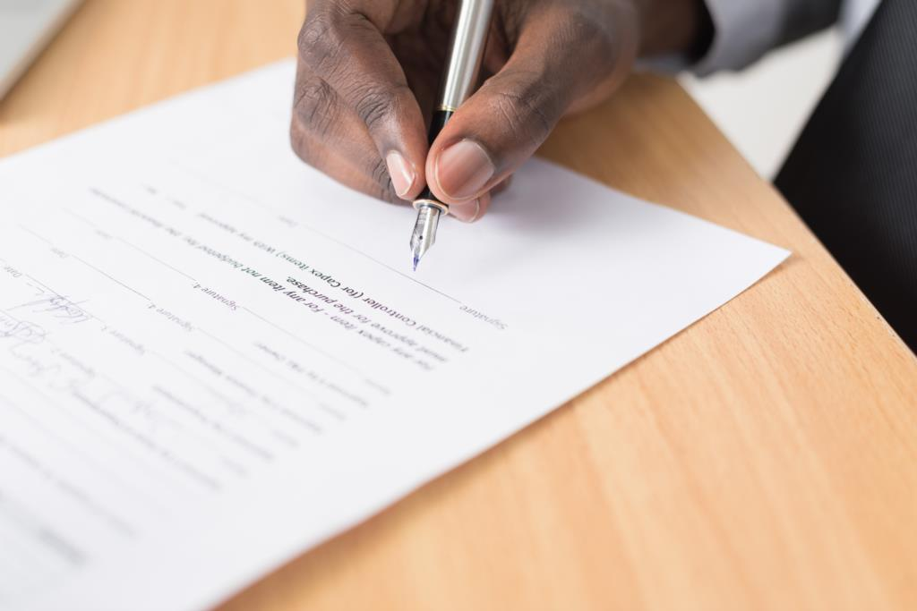
Proposed 2020 Changes
Improve Efficiency & Effectiveness
  Appointment of commissioners and offices set up earlier
  Participate in trainings
  Include the County Auditors in the process earlier
  Increase communications staff

Slide 27
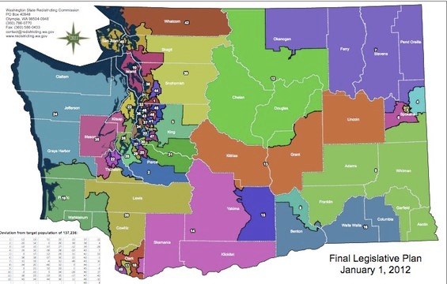
WA Legislative Districts
Notes:
OneAmerica spokesperson Charlie McAteer has pointed out that while the 15th district now has a majority Latino population, it does not yet have a majority of Latino voters since the count includes people under 18, undocumented immigrants, and permanent residents.
There are now four so-called "majority minority" districts in Washington. The other three -- the 11th, 33rd and 37th -- are all in south King County.
four majority-minority legislative districts – the 15th in Yakima County and the 11th, 33rd and 37th in south King County

Slide 28
Proposed 2020 Changes
Increase Transparency
  Increase use of Website, Social media, & other technologies
  Greater amount of deliberations in open meetings
  Make Public priorities

Slide 29
Washington State Redistricting Rules
Maintain Equal Population
Draw Contiguous & Compact Districts
Minimize splitting Political Boundaries
  County and municipality
Preserve Communities of Interest
  Usually interpreted as racial groups
Prohibit Undue Favoritism
  Party or group
  Provide fair and effective representation
  Encourage electoral competition
Notes:
The state constitution requires that congressional and state legislative districts "should be contiguous, compact, and convenient, and follow natural, geographic, artificial, or political subdivision boundaries." The constitution states that the redistricting commission "must not purposely draw plans to favor or discriminate against any political party or group."[14]
State statutes require that congressional and state legislative districts "preserve areas recognized as communities of interest." State statutes also require the commission to draw districts that "provide fair and effective representation" and "encourage electoral competition."[14]
Also in statute – but not discussed here – not relevant at this time.
Nesting is required
Upper chamber district contains two or more intact districts for the lower legislative chamber.

Slide 30
Proposed 2020 Changes
Increase Public Input
  Mandatory number of public meetings
  Greater outreach to media to provide timely information
  Website features including creation of maps

Slide 31
2021
Influence
COMMISSIONER
Selection

Slide 32
Commission Timeline
April 2020 – Census
2021
Jan 31 – Commissioner Appointments
June – First Round of Public Meetings Sept (pre)
Second Round of Public Meetings Nov 15 (post)
2022
March – primaries in new districts

Slide 33





WA Redistricting Commission
Established by constitutional amendment in 1983.
Democrat
Republican
Members of the 2011 Redistricting Commission
Senate
Non-voting Chair
House
  No elected officials or party officers in prior two-year period
  No registered lobbyists within the past year
Notes:
Five-member independent commission,
requires 3 of 4 voting members to pass.
Established by constitutional amendment in 1983.
The majority and minority leaders of the Washington State Senate and Washington House each appoint one registered
No elected officials or party officers in prior two-year period
No registered lobbyists within the past year
Commission's chair:
Non-voting member, non-partisan
Appointed by four other commissioners
In the event that the four voting commissioners cannot agree on a chair, the Washington Supreme Court must appoint one.
Legislature has 30 days to amend the commission's maps by a two-thirds vote in each chamber, can only affect less then 2% of district
Chair: Laura Powell – chemist, corporate and federal gov experience, from Tri Cities.
Sen Rep: Slade Gorton – lawyer,, state house representative AG,congress senator
Sen – Dems: Tim Ceis – lawyer, chief of staff position at city and county,
House Rep: Tom Huff – Sears exec – Retail, former House Representative
House Dems: Dean Foster, - chief clerk, gov gardners chief of staff, served on 2001 commission
Douglas Johnson, a redistricting expert and founder of the National Demographics Corporation, says “they’re pretty clearly better than the legislatures have been at taking the politics out.” Though legislatures are loath to cede power, several states have discussed the idea, with Nebraska and Illinois the most likely to switch to a commission, Johnson says.

Slide 34

2021 Redistricting Commission
Goals:
Women
People of Color
Eastern WA
Experience
Democrat
Republican
Senate
House
Non-voting Chair
  No elected officials or party officers in prior two-year period
  No registered lobbyists within the past year
Notes:
Have Legislative Leadership choose diverse candidate as commissioners.
STEPS
Vet candidates acceptable to parties
Media attention so leadership are more likely to choose diverse candidates
Five-member independent commission,
requires 3 of 4 voting members to pass.
Established by constitutional amendment in 1983.
The majority and minority leaders of the Washington State Senate and Washington House each appoint one registered
No elected officials or party officers in prior two-year period
No registered lobbyists within the past year
Commission's chair:
Non-voting member, non-partisan
Appointed by four other commissioners
In the event that the four voting commissioners cannot agree on a chair, the Washington Supreme Court must appoint one.
Legislature has 30 days to amend the commission's maps by a two-thirds vote in each chamber, can only affect less then 2% of district
Chair: Laura Powell – chemist, corporate and federal gov experience, from Tri Cities.
Sen Rep: Slade Gorton – lawyer,, state house representative AG,congress senator
Sen – Dems: Tim Ceis – lawyer, chief of staff position at city and county,
House Rep: Tom Huff – Sears exec – Retail, former House Representative
House Dems: Dean Foster, - chief clerk, gov gardners chief of staff, served on 2001 commission
Douglas Johnson, a redistricting expert and founder of the National Demographics Corporation, says “they’re pretty clearly better than the legislatures have been at taking the politics out.” Though legislatures are loath to cede power, several states have discussed the idea, with Nebraska and Illinois the most likely to switch to a commission, Johnson says.

Slide 35
Redistricting
TESTIFY
School
Notes:
GOALS
Increase the number of people and the variety of groups testifying
Have high quality testimony that influences the commission
STEPS
Participate in Redistricting Lab
Create and execute “Testifying School”
Identify a Communities of Interest
Identify & connect with community partners
Attend hearings, and testify about the maps

Slide 36

Commissioners’ Feedback
Useful
  understanding local communities
Not Useful
  Unclear about people’s real concerns
  Lacked understanding of the process & progress
  People didn’t have larger context
    Effects of suggested changes
    Political geography of the state
  Same groups at multiple locations
  Lack of understanding of technical resources

Slide 37
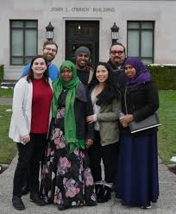
Communities of Interest
“The integrity of communities of interest shall be respected to the extent feasible. For purposes of these Guidelines, a community of interest is defined as an area with recognized similarities of interests, including but not limited to racial, ethnic, geographic, governmental, regional, social, cultural, partisan, or historic interests; county, municipal, or voting precinct boundaries; and commonality of communications. It is inevitable that some interests will be recognized and others will not, however the legislature will attempt to accommodate those felt most strongly by the people in each specific location.”
- Alabama, Legislative guidance

Slide 39
Drawing
2021
MAPS
Notes:
GOAL
Complete Congressional & Legislative District Maps supported by a wide variety of groups submitted to the commission.
STEPS
Talk to a friend or neighbor about their district & let us know!
Host Redistricting Forums and ask about district changes
Solicit technology experts and/or resources
Educate the media about the maps

Slide 40
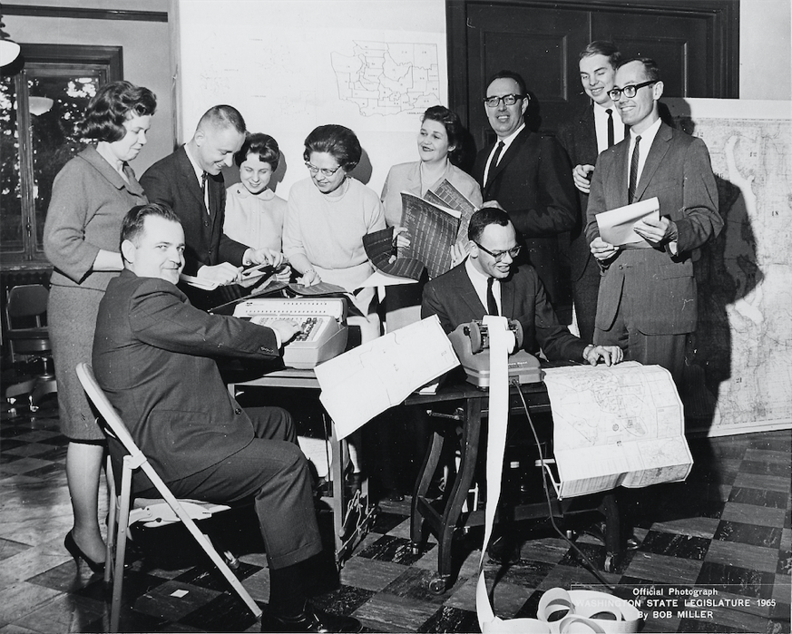
Redistricting Committee 1965

Slide 41
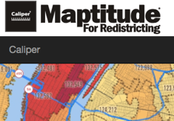




Redistricting Software

Slide 42
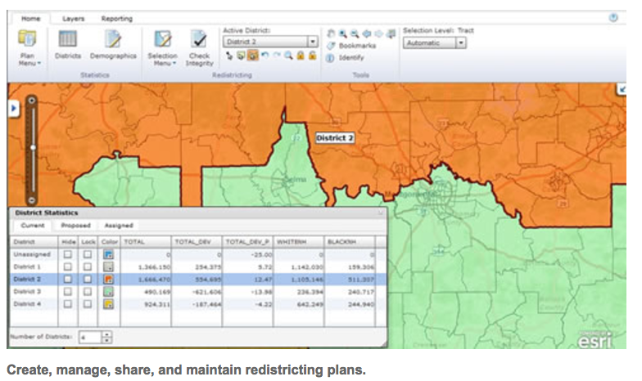
Complex model, quick results

Slide 43

Data Lenses
Race / ethnicity
Socio- Economic / Education
Environmental Factors
Religion and Tribal Affiliation
Business interest / Industry
Notes:
Analyze Washington State from difference perspectives:
Race / ethnicity
Socio- Economic / Education level
Environmental Factors – watershed, habitat
Religion and Tribal Affiliation
Business interest / Industry Employment

Slide 44
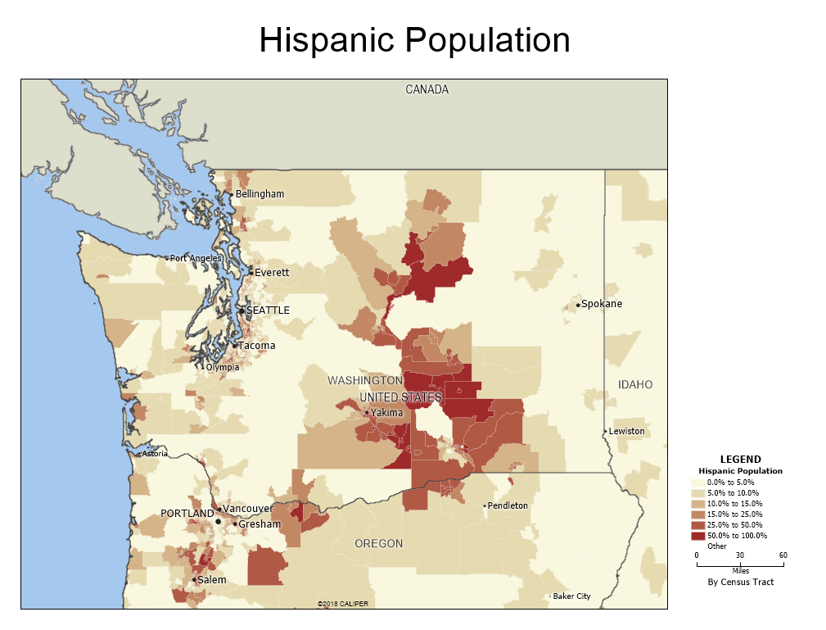
WA Hispanic Population 2017
Notes:
2017 Hispanic population = 12.7%

Slide 45
40% Latino

Slide 46
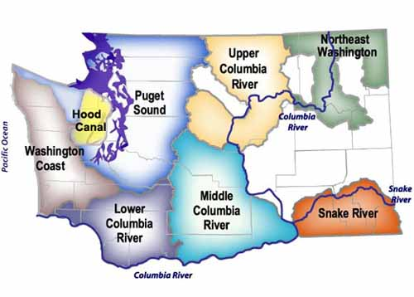

Slide 47
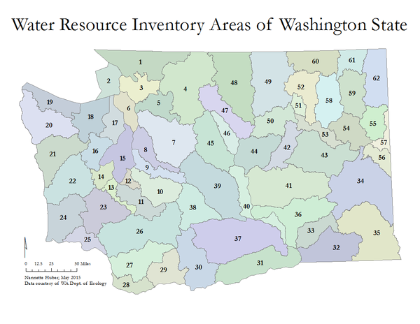
Water Resources Inventory Areas

Slide 48
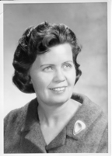

Redistricting Philosophy
Maintain Legislative and Party Leadership
  1/3 safe Democratic districts
  1/3 safe Republican districts
Encourage fresh ideas & require parties to recruit good candidates
  1/3 swing districts
Notes:
Representative Slade Gorton (future WA Attorney General and 3-term U.S. Senator) and Representative Mary Ellen McCaffree planned the 1965 redistricting bill with the following philosophy.

Slide 49
Congressional District Competitiveness
Notes:
District 7 - McDermott before Jayapal in 2016
District 4 Doc hastingsk before Newhouse in 2014

Slide 50
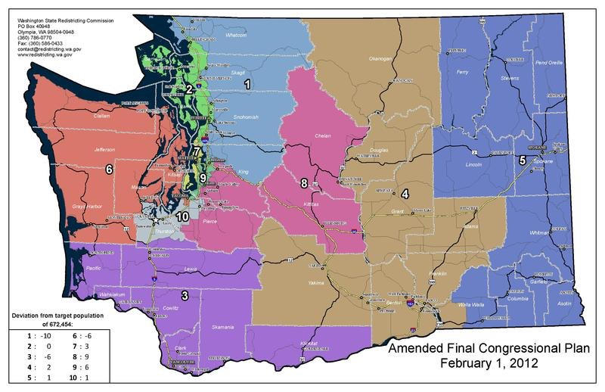
WA Congressional Districts
Notes:
Washington State’s first majority-minority congressional district - District 9
Washington
District 9
11.7% - Hispanic
49.1% - White
11%- Black
0.6% - Native American
21.2% - Asian
1.2% - Pacific Islander
0.3% - Other
5% - Multiple Races
Source: United States Census Bureau, "2009-2013 American Community Survey 5-Year Estimates," accessed April 8, 2015
https://ballotpedia.org/Majority-minority_districts
As of 2013, the United States was home to 113 congressional majority-minority districts. This represented approximately 26 percent of the nation's 435 House districts. 18 are held by Republicans, the rest are held by Democrats.

Slide 51
2031
COMMISSION
STRUCTURE
Notes:
GOAL
Complete Congressional & Legislative District Maps supported by a wide variety of groups submitted to the commission.
STEPS
Talk to a friend or neighbor about their district & let us know!
Host Redistricting Forums and ask about district changes
Solicit technology experts and/or resources
Educate the media about the maps

Slide 52
GOALS
More independent voices
Citizen appointments
Require diversity
Competitive districts prioritized
Notes:
GOAL
Complete Congressional & Legislative District Maps supported by a wide variety of groups submitted to the commission.
STEPS
Talk to a friend or neighbor about their district & let us know!
Host Redistricting Forums and ask about district changes
Solicit technology experts and/or resources
Educate the media about the maps

Slide 53
2011 WA Redistricting Commission
  No elected officials or party officers in prior two-year period
  No registered lobbyists within the past year
Established by constitutional amendment in 1983.
Members of the 2011 Redistricting Commission
Democrat
Republican
Senate
Non-voting Chair
House
Notes:
Five-member independent commission,
requires 3 of 4 voting members to pass.
Established by constitutional amendment in 1983.
The majority and minority leaders of the Washington State Senate and Washington House each appoint one registered
No elected officials or party officers in prior two-year period
No registered lobbyists within the past year
Commission's chair:
Non-voting member, non-partisan
Appointed by four other commissioners
In the event that the four voting commissioners cannot agree on a chair, the Washington Supreme Court must appoint one.
Legislature has 30 days to amend the commission's maps by a two-thirds vote in each chamber, can only affect less then 2% of district
Chair: Laura Powell – chemist, corporate and federal gov experience, from Tri Cities.
Sen Rep: Slade Gorton – lawyer,, state house representative AG,congress senator
Sen – Dems: Tim Ceis – lawyer, chief of staff position at city and county,
House Rep: Tom Huff – Sears exec – Retail, former House Representative
House Dems: Dean Foster, - chief clerk, gov gardners chief of staff, served on 2001 commission
Douglas Johnson, a redistricting expert and founder of the National Demographics Corporation, says “they’re pretty clearly better than the legislatures have been at taking the politics out.” Though legislatures are loath to cede power, several states have discussed the idea, with Nebraska and Illinois the most likely to switch to a commission, Johnson says.

Slide 54
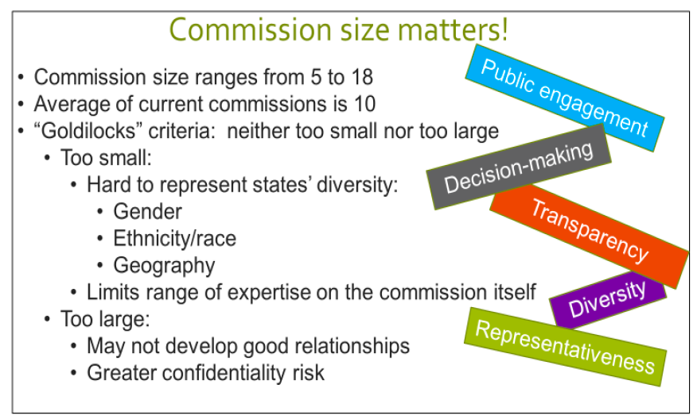
Commission Size

Slide 55
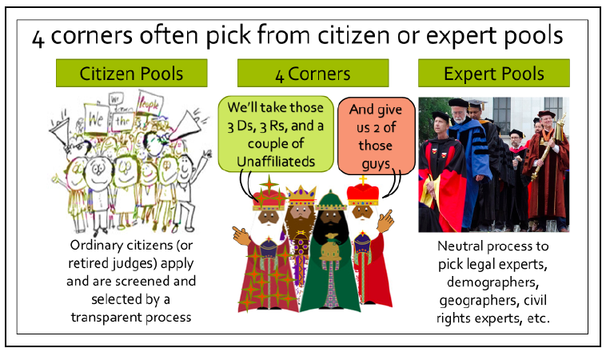
Additional Members

Slide 56
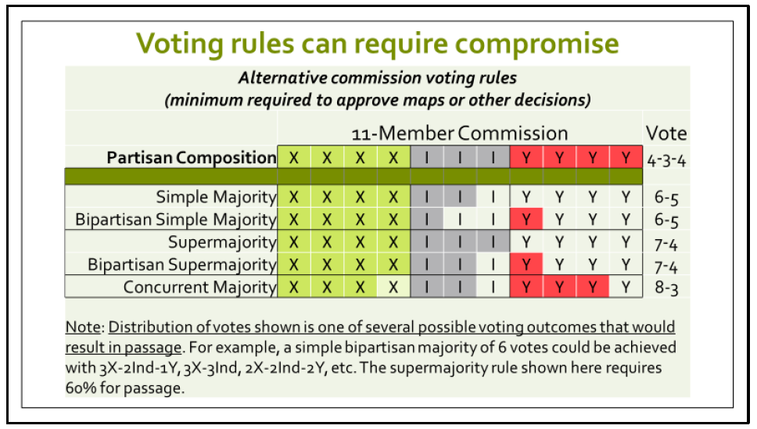
Commission Voting

Slide 57

California Commission
14 members
  5 Democrats
  5 Republicans
  4 Unaffiliated
Decides:
  Legislative Districts
  (40 – Senate, 80 - Assembly),
  Congressional Districts (53) and
  Board of Equalization – CA tax commission(4)
Complex Process for selections
Notes:
California Citizens Commission
14 members
5 Majority Party (Democrat)
5 Minority Party (“second most popular” Republican)
4 non-affiliated
Decides Legislative Districts (40), Congressional Districts (53) and Board of Equalization – CA tax commission (4)
Process for selections
State Auditor collected 5,000 completed applications ( 35K appied, 5k qualified)
3 Auditors selected 20 for each pool.
Majority and Minority Party in each house selected 12 for each pool
Auditor pulled 8 commissioners randomly - (3,3,2)
First 8 commissioners pick the the remaining 6 - (2,2,2)

Slide 58
2031 WA Redistricting Commission
  No elected officials or party officers in prior two-year period
  No registered lobbyists within the past year
Proposed Commission Structure
Senate
House
“Citizen”
Unaffiliated - Citizens
Democrat
Non-voting Chair
Republican
Notes:
Chair: Laura Powell – chemist, corporate and federal gov experience, from Tri Cities.
Sen Rep: Slade Gorton – lawyer,, state house representative AG,congress senator
Sen – Dems: Tim Ceis – lawyer, chief of staff position at city and county,
House Rep: Tom Huff – Sears exec – Retail, former House Representative
House Dems: Dean Foster, - chief clerk, gov gardners chief of staff, served on 2001 commission
Douglas Johnson, a redistricting expert and founder of the National Demographics Corporation, says “they’re pretty clearly better than the legislatures have been at taking the politics out.” Though legislatures are loath to cede power, several states have discussed the idea, with Nebraska and Illinois the most likely to switch to a commission, Johnson says.

Slide 59
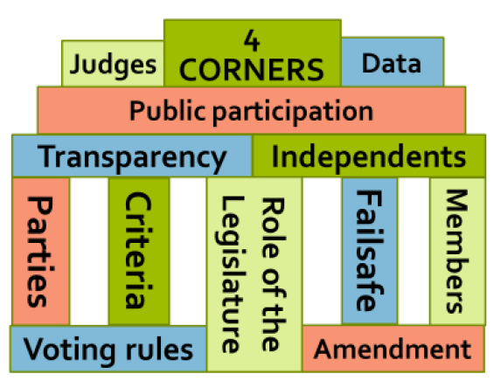

Slide 60
Many Maps,
One Voice
LWV Tribute
Marketing
Education
Civic Engagement
Todays Issues

Slide 61
Centennial Grants Program
High Schools
  Seattle (Fall 2019)
  Spokane (Spring 2020)
Pre-Post Play Modules
Public Performances

Slide 62
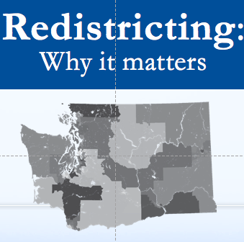
Forum Grant
LWVWA Civic Ed Fund
  $400
Pre-Approved Grant
Train the Trainer
  Webseminar
  Individual training
lwvwa.org/redistricting-forum

Slide 63
WA Redistricting Actions
®
2020 CENSUS Outreach
2021 REDISTRICTING (and beyond)
2020 Session Bills
Influence Commission Choices
Testify School
Making the Maps
2031 REDISTRICTING (start now)
New Commission Structure

Slide 64
COUNTDOWN
2017-2019
Educate & Engage
2019
Energize Communities of Interest
2020
Publicize & Volunteer for Census
2021
Testify. Maps. Transparency.
Notes:
Now (2015-20) – Census Bureau Planning Committee for 2020
2017-19 – Budget appropriations for Census work
April 1, 2020 – Census conducted
December 31, 2020 – official numbers sent to Office of the President
Jan 25, 2021– Clerk of US House informs states of their apportionment
Feb – Mar 2021 – Data from Census Bureau released
May 2021 – Municipalities are informed of their populations
Nov 2021 – Redistricting Committee Map Deadline
January 2022 – Municipality must submit district plans – public has 15 days to contest (same principals as state)

Slide 65
Questions
Notes:
What criteria would you use? to ensure that districts fairly represent the people of our state?
How would you like to see Washington State’s districts defined differently?
What other actions can we take to insure a fair and transparent redistricting process?

Slide 66
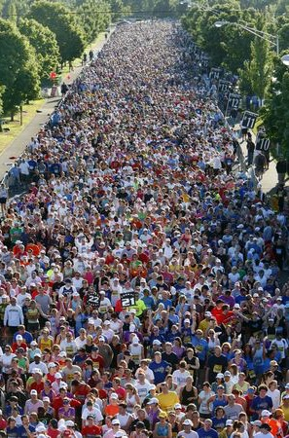
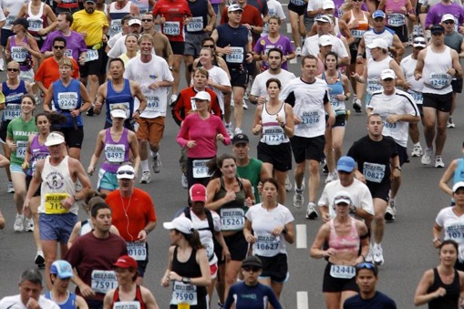
Government only works if we participate

Slide 67

Contact ME
Alison McCaffree
Director, Politics of the Possible in Action
LWVWA Census & Redistricting Issue Chair
253-720-6813
Alison.Mccaffree@stanfordalumni.org

